Slide 1
Class 5: Recurrent Neural Networks

Slide 2
Outline
Go from deep learning to recurrent neural networks
Introduction to sequential modelling and RNNs
Challenges: vanishing gradients
Long Short‑Term Memory (LSTM) mechanics
Manual implementation & weather example
Comparing RNNs and LSTMs
Practical tips & frameworks
Predict the weather!
[3] [4]

Slide 3
Why Sequential Models?
Traditional neural networks treat inputs independently, ignoring temporal context
Sequential data (audio, language, weather) requires models with memory
RNNs introduce a hidden state that carries information from prior time steps
 | Feedforward | RNN
Memory | No internal memory | Maintains hidden state
Parameter sharing | Across layers | Across time steps
Applications | Image classification, tabular data | Time series, NLP, weather forecasting!

Slide 4
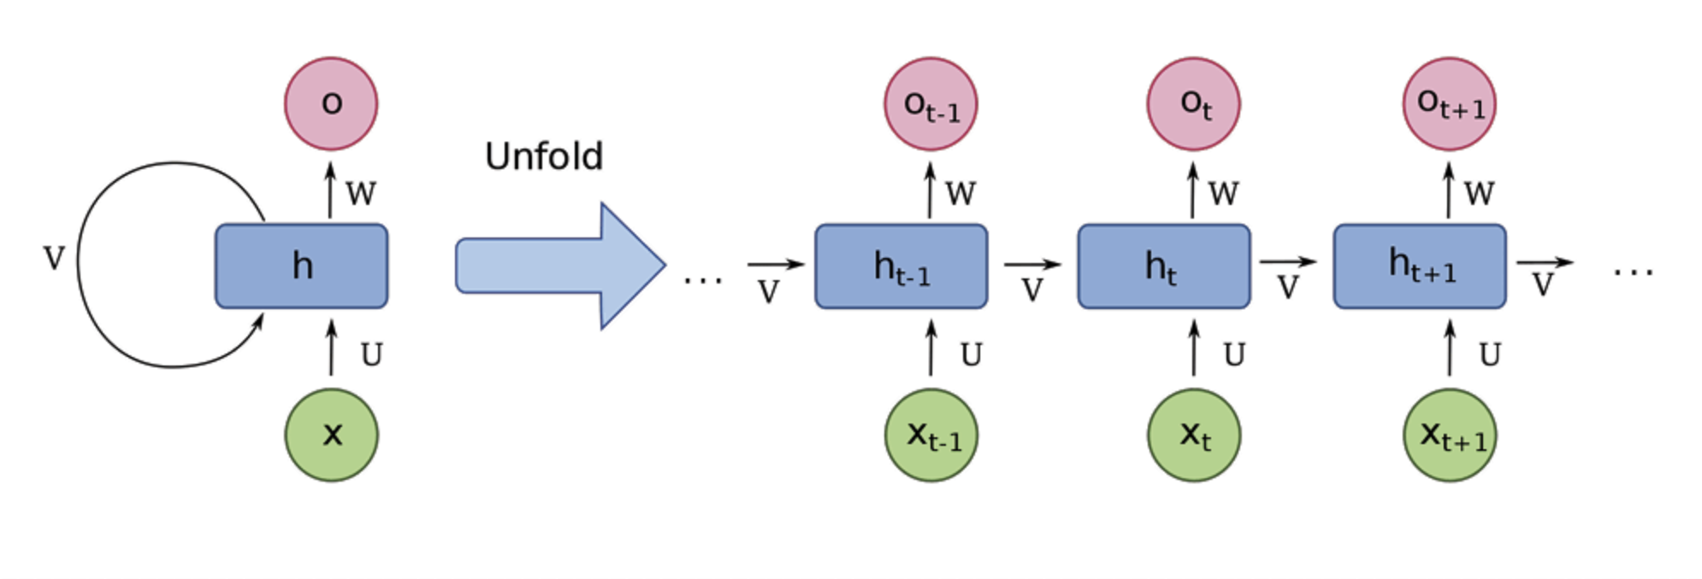
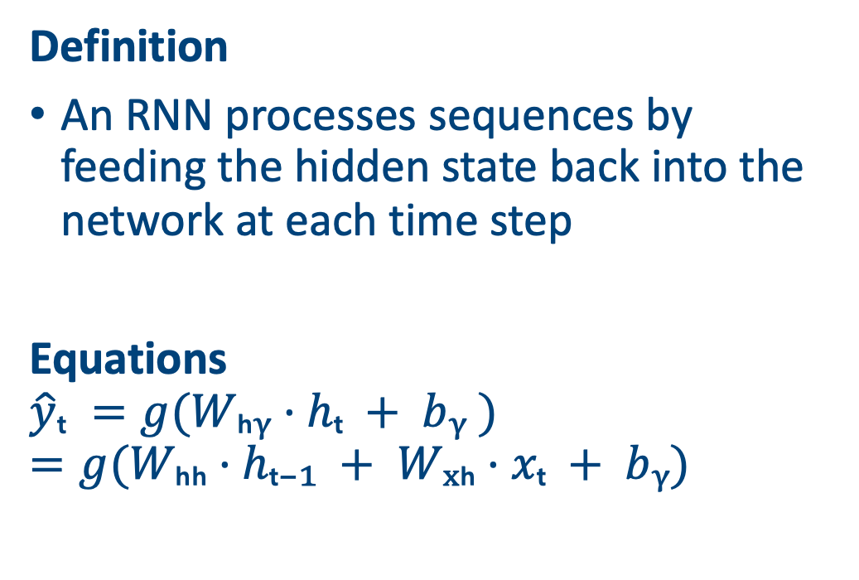
Recurrent Neural Networks
Definition
An RNN processes sequences by feeding the hidden state back into the network at each time step
Equations
$$\hat{y}ₜ =g(Wₕᵧ·hₜ + bᵧ )=g⁡(Wₕₕ·hₜ₋₁ + Wₓₕ·xₜ + bᵧ)$$
Picture from https://www.techtarget.com/searchenterpriseai/definition/recurrent-neural-networks
Notes:
Re-create this picture to match my notation

Slide 5
Training RNNs & BPTT
Backpropagation Through Time
To train an RNN, the sequence is unrolled over time and gradients are accumulated across all time steps. This process is known as backpropagation through time (BPTT)
Challenges
Gradients can explode or vanish when propagated through many time steps, making learning long‑range dependencies difficult

Slide 6
A weather prediction task
Use historical measurements of temperature, rainfall and humidity to predict the next day’s weather
3 variables: temperature (°C), rainfall (mm), humidity (%)
We consider a 5‑day window to forecast the 6th day
Let’s go through a simple RNN on the board
Day | Temp (°C) | Rain (mm) | Humidity (%)
D1 | 20.9 | 4.23 | 69.48
D2 | 20.5 | 5.67 | 68.75
D3 | 21.0 | 6.10 | 67.04
D4 | 21.9 | 5.77 | 66.44
D5 | 22.0 | 6.60 | 62.20

Slide 7
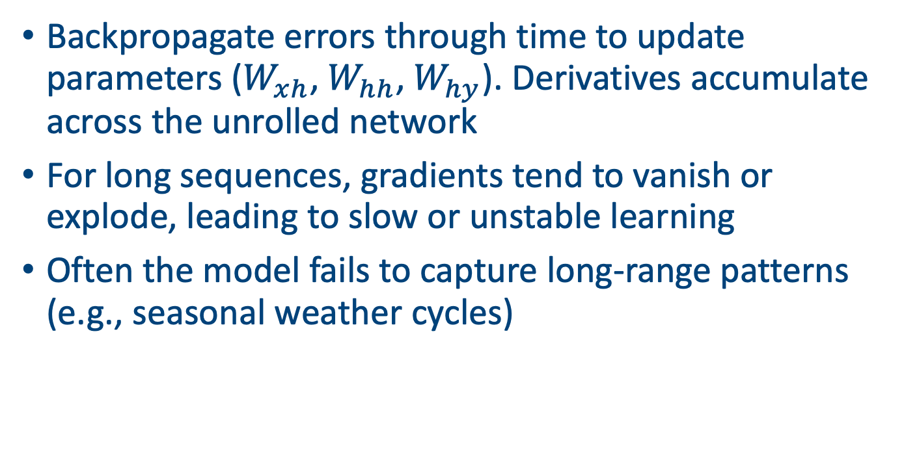
Training the RNN
Backpropagate errors through time to update parameters ($W_{xh}$, $W_{hh}$,$W_{hy}$). Derivatives accumulate across the unrolled network
For long sequences, gradients tend to vanish or explode, leading to slow or unstable learning
Often the model fails to capture long‑range patterns (e.g., seasonal weather cycles)

Slide 8
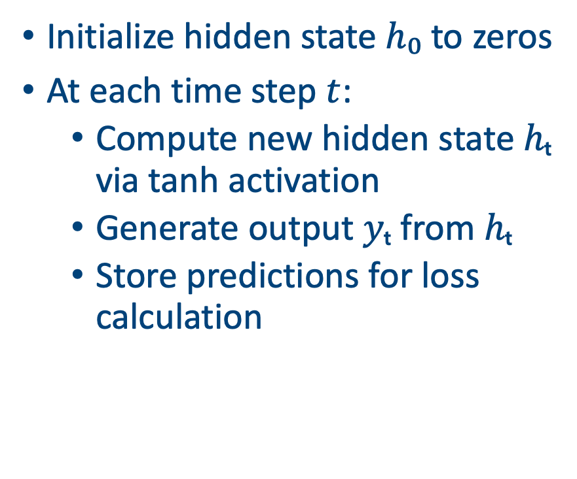
Implementation of an RNN
Initialize hidden state $h₀$ to zeros
At each time step $t$:
Compute new hidden state $hₜ$ via tanh activation
Generate output $yₜ$ from $hₜ$
Store predictions for loss calculation
import numpy as np
# weights and biases
Wxh = np.random.randn(input_dim, hidden_dim)
Whh = np.random.randn(hidden_dim, hidden_dim)
bh = np.zeros((1, hidden_dim))
Why = np.random.randn(hidden_dim, output_dim)
by = np.zeros((1, output_dim))
# forward pass
h_prev = np.zeros((1, hidden_dim))
y_preds = []
for t in range(T):
x_t = X[t] # shape (1, input_dim)
h_prev = np.tanh(x_t @ Wxh + h_prev @ Whh + bh)
y_t = h_prev @ Why + by
y_preds.append(y_t)

Slide 9
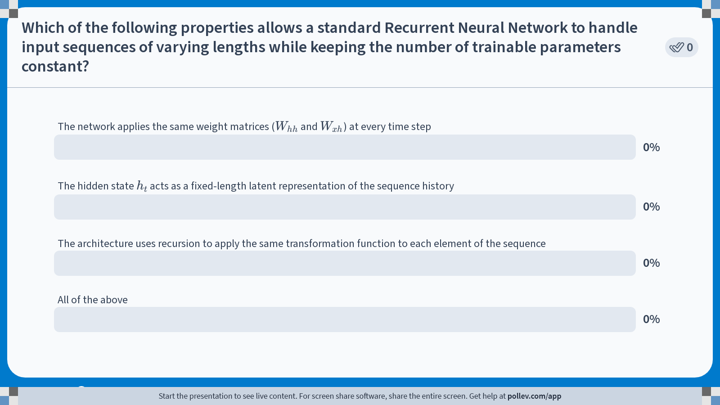
Notes:
Do not modify the notes in this section to avoid tampering with the Poll Everywhere activity. More info at polleverywhere.com/support Which of the following properties allows a standard Recurrent Neural Network to handle input sequences of varying lengths while keeping the number of trainable parameters constant?
https://www.polleverywhere.com/multiple_choice_polls/SlUK7xUZGy47LKoc5TzCU?state=opened&flow=Default&onscreen=persist

Slide 10
Long Short Term Memory Networks (LSTMs)

Slide 11
Long Short‑Term Memory (LSTM)
Motivation
LSTMs were proposed to overcome vanishing gradients by introducing a dedicated long term memory cell
Key idea
Control the flow of information with ‘gates’ that learn when to forget past data, when to incorporate new input and when to expose the memory to the rest of the network

Slide 12
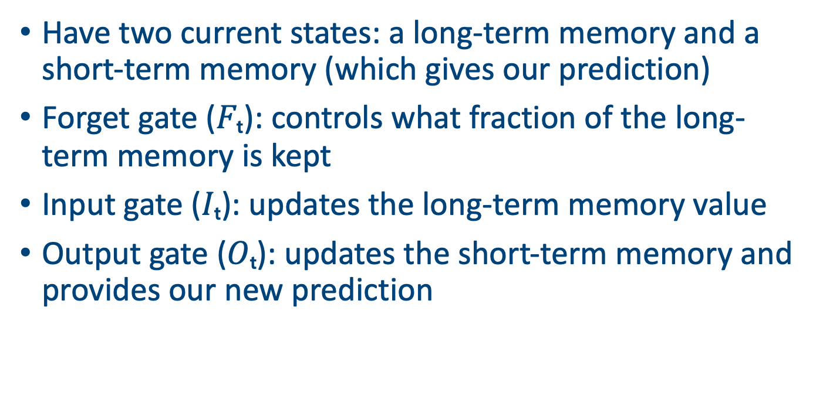
Anatomy of an LSTM Cell
Have two current states: a long-term memory and a short-term memory (which gives our prediction)
Forget gate ($Fₜ$): controls what fraction of the long-term memory is kept
Input gate ($Iₜ$): updates the long-term memory value
Output gate ($Oₜ$): updates the short-term memory and provides our new prediction

Slide 13
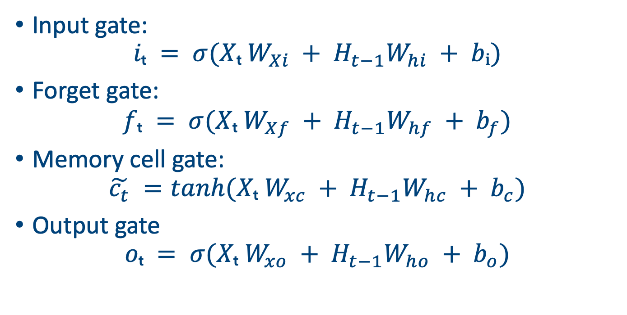
First set of gates
Input gate:
$$iₜ = σ(Xₜ W_{Xi} + H_{t−1}W_{hi} + bᵢ)$$
Forget gate:
$$fₜ = σ(Xₜ W_{Xf} + H_{t−1}W_{hf} + b_{f})$$
Memory cell gate:
$$\tilde{c_{t}} =tanh(Xₜ W_{xc} + H_{t−1}W_{hc} + b_{c})$$
Output gate
$$oₜ = σ(Xₜ W_{xo} + H_{t−1}W_{ho} + b_{o})$$

Slide 14
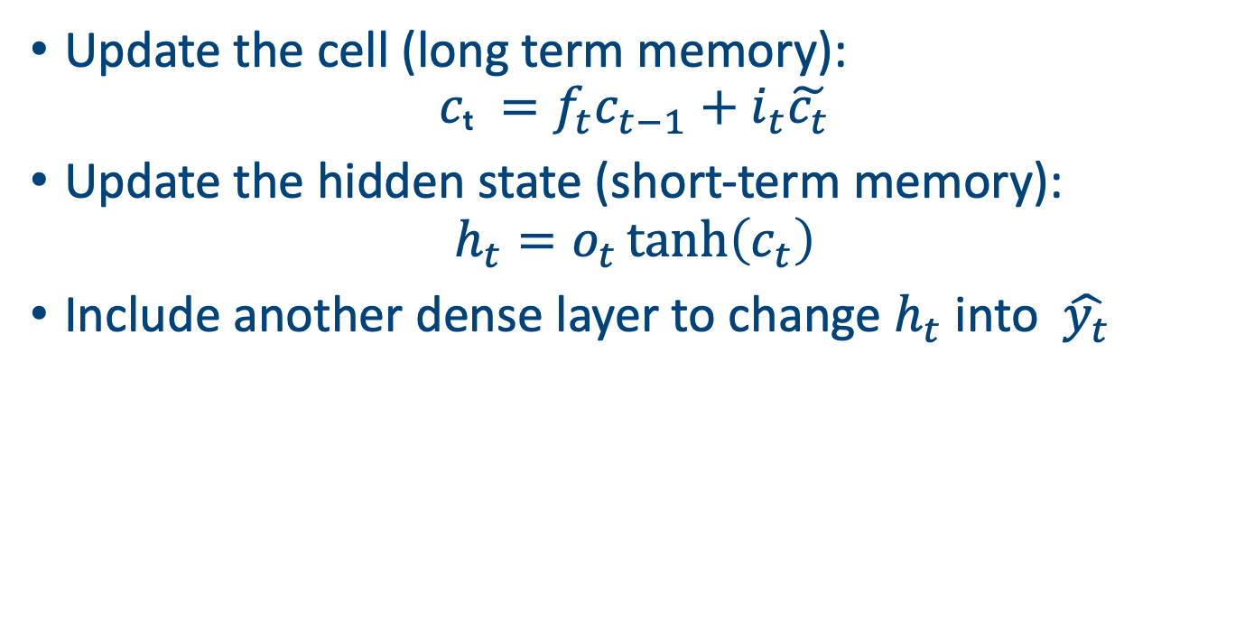
Updates
Update the cell (long term memory):
$$cₜ =f_{t}c_{t−1}+i_{t}\tilde{c_{t}}$$
Update the hidden state (short-term memory):
$$h_{t}=o_{t}\tanh\left(c_{t}\right)$$
Include another dense layer to change $h_{t}$ into $\hat{y_{t}}$

Slide 15
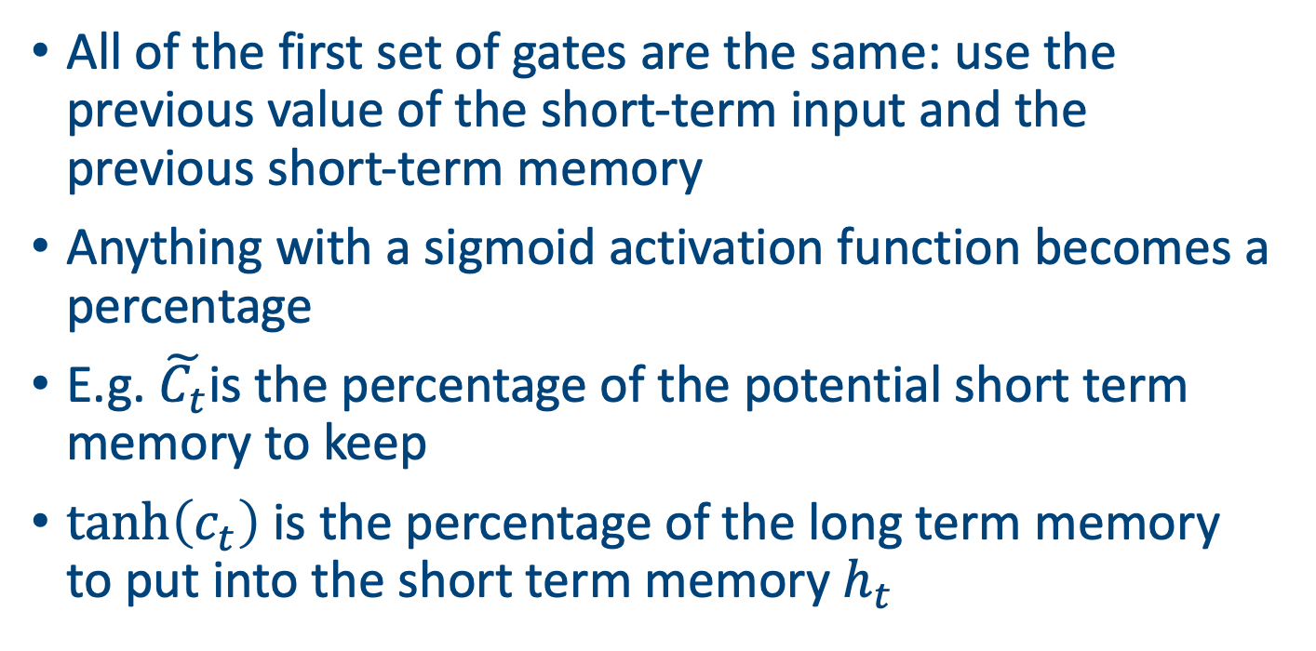
Intuition
All of the first set of gates are the same: use the previous value of the short-term input and the previous short-term memory
Anything with a sigmoid activation function becomes a percentage
E.g. $\tilde{C_{t}}$is the percentage of the potential short term memory to keep
$\tanh\left(c_{t}\right)$ is the percentage of the long term memory to put into the short term memory $h_{t}$

Slide 16
LSTM diagram
All made more straightforward with an example on the board

Slide 17
Preparing Input Sequences
Windowing
Create training examples by sliding a fixed‑length window over the data
Normalisation
Scale each feature to zero mean and unit variance to ensure stable learning
Training/Testing split
Divide the sequences into training and validation sets to evaluate performance

Slide 18
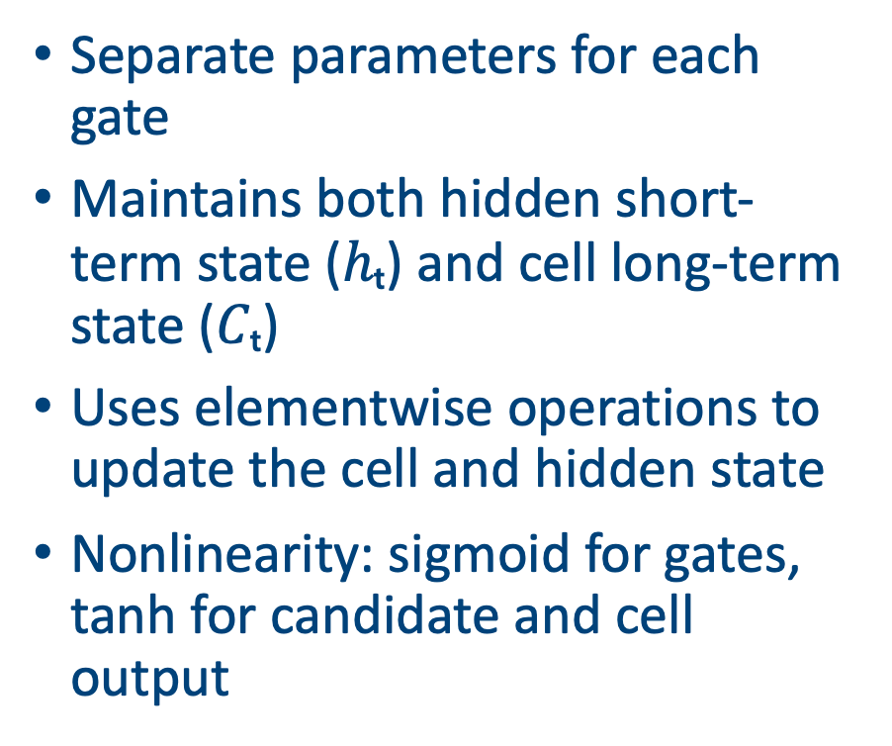
Implementing the LSTM
Separate parameters for each gate
Maintains both hidden short-term state ($hₜ$) and cell long-term state ($Cₜ$)
Uses elementwise operations to update the cell and hidden state
Nonlinearity: sigmoid for gates, tanh for candidate and cell output
import numpy as np
# initialise weights for gates
Wxi,Wxf,Wxo,Wxc = [np.random.randn(input_dim, hidden_dim) for _ in range(4)]
Whi,Whf,Who,Whc = [np.random.randn(hidden_dim, hidden_dim) for _ in range(4)]
bi,bf,bo,bc = [np.zeros((1, hidden_dim)) for _ in range(4)]
Wy = np.random.randn(hidden_dim, output_dim)
by = np.zeros((1, output_dim))
# forward pass
h_prev = np.zeros((1, hidden_dim))
C_prev = np.zeros((1, hidden_dim))
y_preds = []
for t in range(T):
x_t = X[t]
I = sigmoid(x_t @ Wxi + h_prev @ Whi + bi)
F = sigmoid(x_t @ Wxf + h_prev @ Whf + bf)
O = sigmoid(x_t @ Wxo + h_prev @ Who + bo)
C_tilde = np.tanh(x_t @ Wxc + h_prev @ Whc + bc)
C_prev = F * C_prev + I * C_tilde
h_prev = O * np.tanh(C_prev)
y_t = h_prev @ Wy + by
y_preds.append(y_t)

Slide 19
LSTM Training & Predictions
Use gradient descent and backpropagation through time to update all gate parameters
The LSTM learns to follow the general trend of the weather variables and reduce forecasting error over time
Can produce similar graphs for rainfall and humidity

Slide 20
RNN vs LSTM: A Comparison
LSTMs trade computational efficiency for better performance on long sequences
When sequence lengths are short, a simple RNN may suffice
For very long sequences or parallelisable tasks, Transformer architectures might be preferred
Coming next!
 | RNN | LSTM
Memory | Single hidden state hₜ | Hidden state hₜ and cell state Cₜ
Gates | None | Input, forget & output gates
Vanishing gradient | Severe | Mitigated
Parameter count | Fewer | More due to multiple gates
Use cases | Short sequences | Long‑range dependencies

Slide 21
Implementing LSTM with PyTorch
import torch, torch.nn as nn
lstm = nn.LSTM(input_size=1, hidden_size=8, num_layers=1)
readout = nn.Linear(8, 1) # Turns the hidden layer into a single output
opt = torch.optim.Adam(list(lstm.parameters())+list(readout.parameters()), lr=0.1)
for _ in range(300):
h, _ = lstm(x)
yhat = readout(h)
loss = ((yhat - y)**2).mean()
opt.zero_grad(); # Clears old gradients
loss.backward(); # Computes the gradients and the loss function
opt.step() # Updates the parameters
print(f"final MSE: {loss.item():.4f}")

Slide 22
Other applications of RNNs/LSTMs
Natural language processing: language modelling, machine translation, sentiment analysis
Speech recognition and synthesis
Time‑series forecasting (weather obvs, finance, IoT)
Biological sequence analysis: DNA/RNA modelling
Music generation and audio signal processing

Slide 23
Other RNNs
Gated Recurrent Unit (GRU)
Simplified version of LSTM with fewer gates (update and reset). Competitive performance with fewer parameters
Bidirectional RNN/LSTM
Processes sequences forwards and backwards to capture past and future context
Transformers
Self‑attention mechanisms remove recurrence entirely, enabling parallel processing and better long‑range modelling

Slide 24
Practical tips
Normalise and scale your inputs to accelerate convergence
Choose sequence length based on the task’s (maximum) temporal dependencies
Use regularization (dropout, L2) and gradient clipping to prevent overfitting and exploding gradients
Monitor training/validation curves to detect underfitting or overfitting
If LSTMs don’t work for you, experiment with other types of RNN
In weather forecasting, we often use sequence-to-sequence models (i.e. multiple outputs – 10 days ahead)
For forecasting more days ahead we use the latest prediction as the next input, also called autoregressive rollout

Slide 25
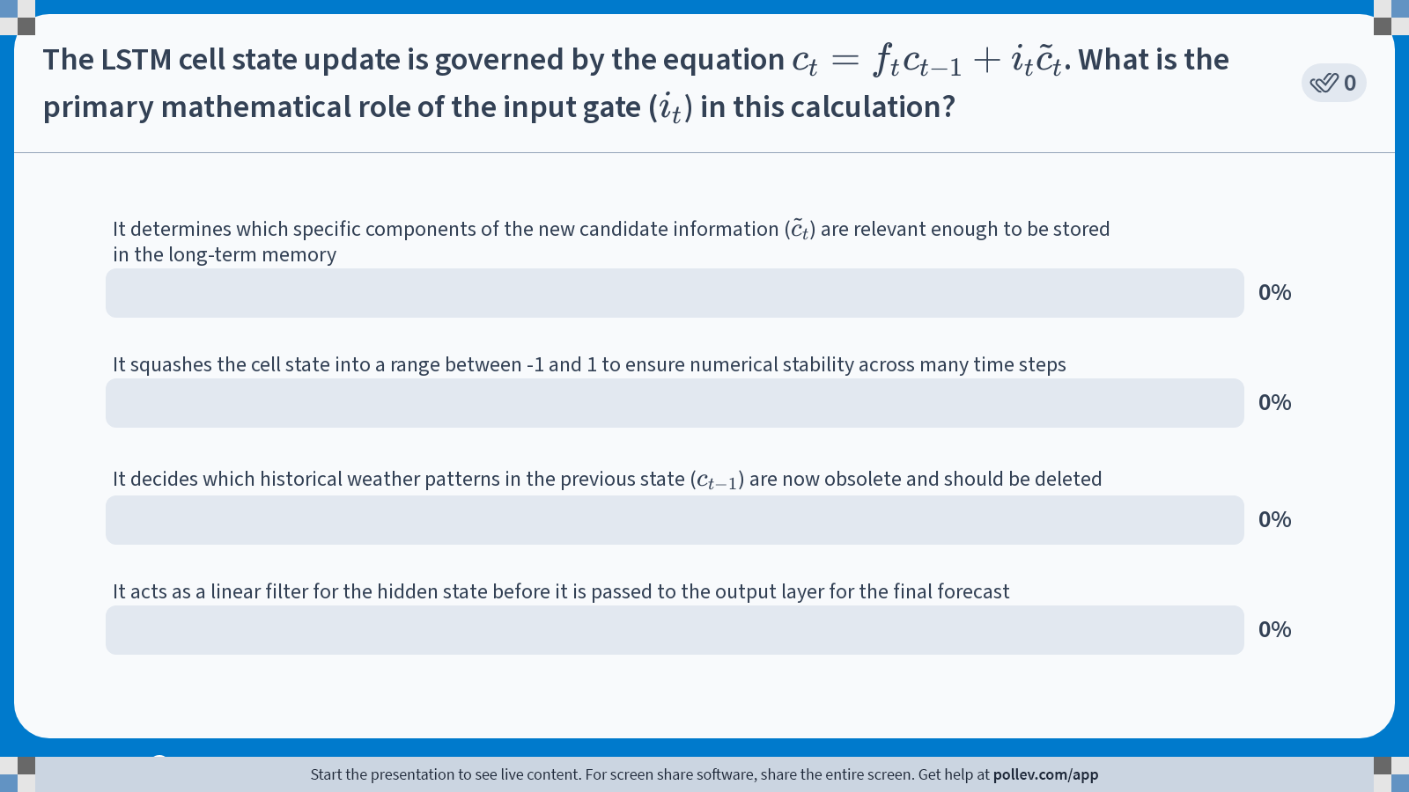
Notes:
Do not modify the notes in this section to avoid tampering with the Poll Everywhere activity. More info at polleverywhere.com/support The LSTM cell state update is governed by the equation $$c_t = f_t c_{t-1} + i_t \tilde{c}_t$$. What is the primary mathematical role of the input gate ($$i_t$$) in this calculation?
https://www.polleverywhere.com/multiple_choice_polls/RvcVhsLYmkHmKcquKPsgk?state=opened&flow=Default&onscreen=persist

Slide 26
Summary
RNNs enable sequential modelling by maintaining a hidden state but struggle with gradients
LSTMs introduce gates and a cell state to mitigate these issues and learn long‑range dependencies
Manual implementations provide insight into the underlying operations and challenges
Practical applications span NLP, speech, time‑series analysis and beyond
Modern frameworks (Keras/PyTorch) simplify experimentation and deployment

